Slide 1



Hospitality Domain Project 1.0
View in Power BI
Last data refresh:
06/01/2025
Created by:
Deepanshu

Slide 2
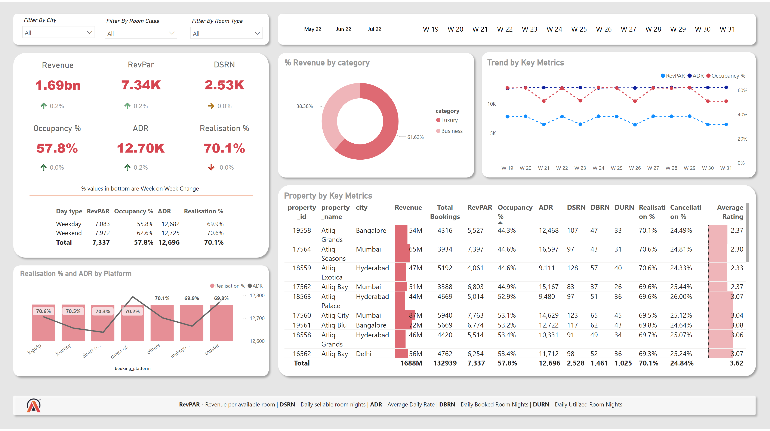
Home
Notes:
Property by Key Metrics
No alt text provided
slicer
No alt text provided
slicer
No alt text provided
slicer
No alt text provided
slicer
No alt text provided
Revenue
No alt text provided
tableEx
No alt text provided
% Revenue by category
No alt text provided
RevPar
No alt text provided
tableEx
No alt text provided
DSRN
No alt text provided
tableEx
No alt text provided
Occupancy %
No alt text provided
tableEx
No alt text provided
ADR
No alt text provided
tableEx
No alt text provided
Realisation %
No alt text provided
tableEx
No alt text provided
tableEx
No alt text provided
Trend by Key Metrics
No alt text provided
Realisation % and ADR by Platform
No alt text provided
shape
No alt text provided
slicer
No alt text provided
shape
No alt text provided
shape
No alt text provided
shape
No alt text provided
textbox
No alt text provided
shape
No alt text provided
shape
No alt text provided
shape
No alt text provided
shape
No alt text provided
shape
No alt text provided
textbox
No alt text provided
image
No alt text provided

Slide 3
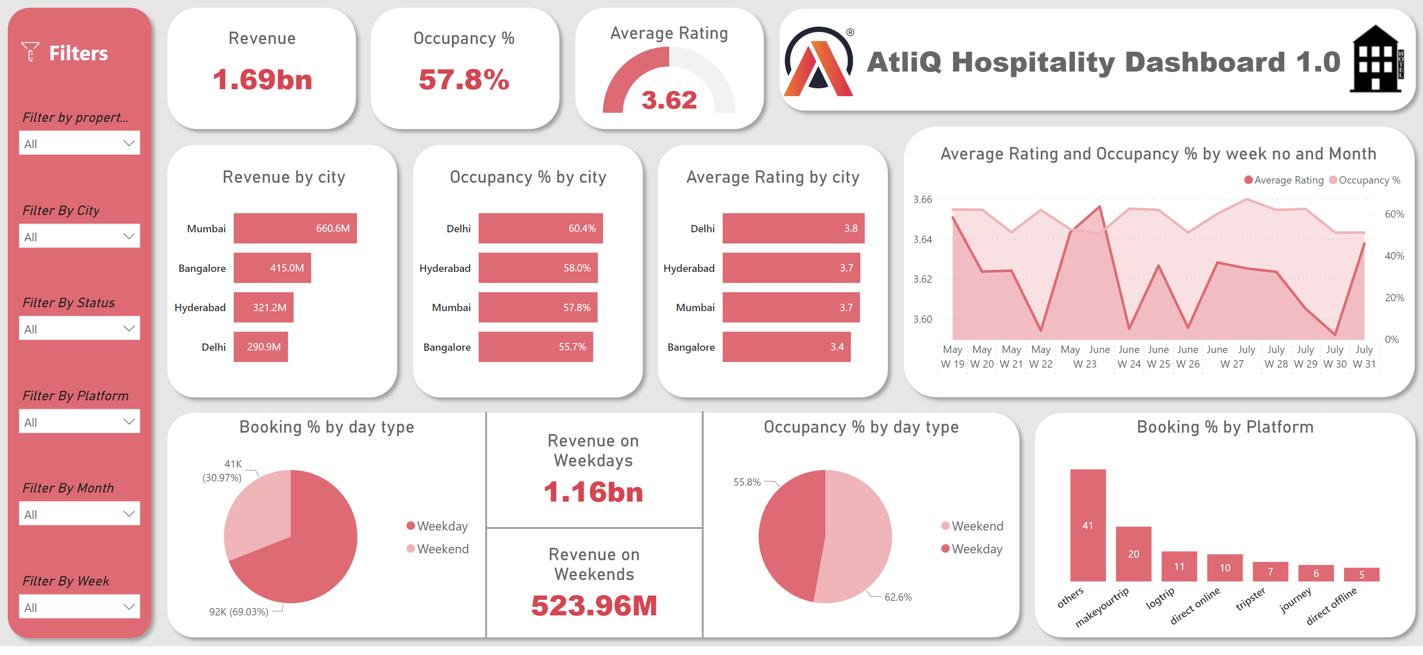
Page-1
Notes:
slicer
No alt text provided
Revenue
No alt text provided
Booking % by day type
No alt text provided
Occupancy %
No alt text provided
Average Rating and Occupancy % by week no and Month
No alt text provided
shape
No alt text provided
image
No alt text provided
shape
No alt text provided
slicer
No alt text provided
textbox
No alt text provided
slicer
No alt text provided
slicer
No alt text provided
slicer
No alt text provided
slicer
No alt text provided
shape
No alt text provided
shape
No alt text provided
shape
No alt text provided
gauge
No alt text provided
shape
No alt text provided
image
No alt text provided
textbox
No alt text provided
clusteredBarChart
No alt text provided
clusteredBarChart
No alt text provided
clusteredBarChart
No alt text provided
shape
No alt text provided
shape
No alt text provided
shape
No alt text provided
shape
No alt text provided
shape
No alt text provided
Revenue on Weekdays
No alt text provided
shape
No alt text provided
shape
No alt text provided
Revenue on Weekends
No alt text provided
Occupancy % by day type
No alt text provided
Booking % by Platform
No alt text provided
shape
No alt text provided
image
No alt text provided

Slide 4
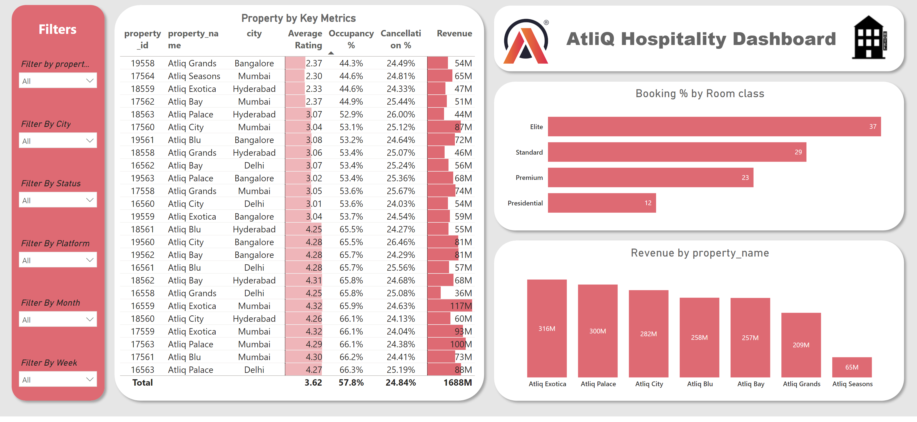
Page-2
Notes:
slicer
No alt text provided
image
No alt text provided
shape
No alt text provided
slicer
No alt text provided
textbox
No alt text provided
slicer
No alt text provided
slicer
No alt text provided
slicer
No alt text provided
slicer
No alt text provided
shape
No alt text provided
image
No alt text provided
textbox
No alt text provided
Booking % by Room class
No alt text provided
shape
No alt text provided
clusteredColumnChart
No alt text provided
shape
No alt text provided
Property by Key Metrics
No alt text provided
shape
No alt text provided

